Slide 1
Image Approximation via Semi-Transparent Shape Evolution
Matteo Liotta
SM3800072
Optimization for Artificial Intelligence, 2025, UniTS - Final Project

Slide 2
Problem Introduction

Slide 3

Problem Introduction
This project is a revisit of the “Genetic-lisa” Peter Braden’s project, which aims to recreate images with genetic algorithms.,
It had different implementations over time, from Python to C
The base concept is to evolve an image…
defined as a series of overlapping shapes
/w (shape and color) mutation
/w selection on image fitness
/w crossover
… to reach a certain level of similitude with the original picture.

Slide 4
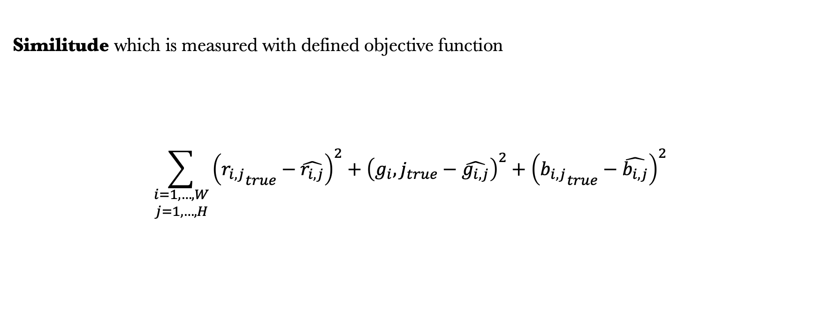
Problem Introduction
Similitude which is measured with defined objective function
$$\sum_{\begin{matrix}i=1,…,W \\ j=1,…,H\end{matrix}}{{\left({r_{i,j}}_{true}−\hat{r_{i,j}}\right)}^{2}+{\left({g_{i},j}_{true}−\hat{g_{i,j}}\right)}^{2}+{\left({b_{i,j}}_{true}−\hat{b_{i,j}}\right)}^{2}}$$

Slide 5
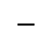
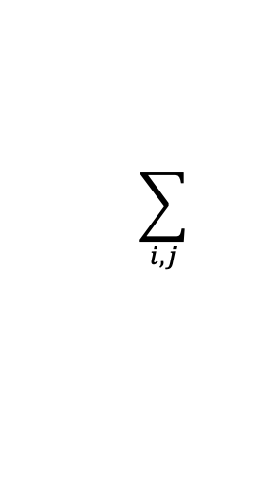
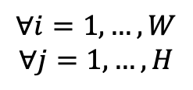
Problem Introduction
Similitude which is measured with defined objective function
(
)
2
$$\sum_{i,j}{ }$$
$$∀i=1,…,W$$
$$∀j=1,…, H$$
$$−$$
Reference
Evol. Image
( i,j )

Slide 6
How are individuals defined?

Slide 7
How are individuals defined?
Shapes
Color

Slide 8
How are individuals defined?
Shape Definition
In the original code different shapes are proposed, but here we can focus on
Ellipses
Rectangle
Triangles
defined as a dictionary of name and coordinates
{'type': 'triangle', 'coords': [44, 213, 93, 148, 163, 220]}

Slide 9
How are individuals defined?
Shape Definition
In the original code different shapes are proposed, but here we can focus on
Ellipses
Rectangle
Triangles
defined as a dictionary of name and coordinates
{'type': 'triangle', 'coords': [44, 213, 93, 148, 163, 220]}
(x,y)
(x,y)
(x,y)

Slide 10
How are individuals defined?
Shape Definition
In the original code different shapes are proposed, but here we can focus on
Ellipses
Rectangle
Triangles
defined as a dictionary of name and coordinates
{'type': 'rectangle', 'coords': [31, 136, 48, 160]}
{'type': ‘ellispes', 'coords': [31, 136, 48, 160]}

Slide 11
How are individuals defined?
Shape Definition
In the original code different shapes are proposed, but here we can focus on
Ellipses
Rectangle
Triangles
defined as a dictionary of name and coordinates
y
y + shape height
{'type': 'rectangle', 'coords': [31, 136, 48, 160]}
{'type': ‘ellipse', 'coords': [31, 136, 48, 160]}
x
x + shape width

Slide 12
Shape Color Definition
Also color could be generated, but the original code introduced (and didn’t used) the prev input
def generate_color(prev = None, a_mutation = (-0x5,0x3), rgb_mutation = (-0x5,0x3)):
if prev:
return (prev[0] + random.randint(*a_mutation), # R
prev[1] + random.randint(*rgb_mutation), # G
prev[2] + random.randint(*rgb_mutation), # B
prev[3] + random.randint(*rgb_mutation)) # A
return (random.randint(0x33, 0x99), # R
random.randint(0, 0xff), # G: between 0 and 255
random.randint(0, 0xff), # B: between 0 and 255
random.randint(0, 0xff)) # A: between 0 and 255

Slide 13
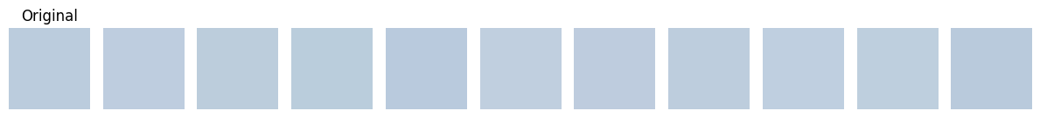
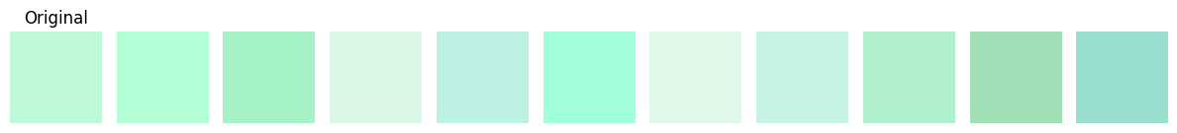
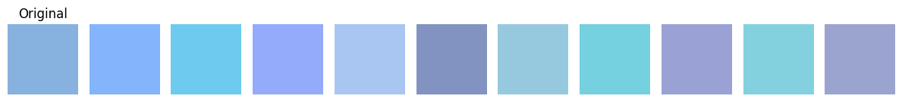
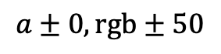
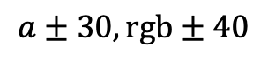
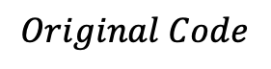
Shape Color Definition
This will be used inside the individual shape mutation: using the prev parameter we could eventually mutate the color avoiding random re-generation
$$Original Code$$
$$a±0,rgb±50$$
$$a±30,rgb±40$$
Notes:
… But here additional range parameters has been introduced for better mutation performances

Slide 14
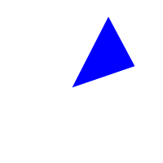

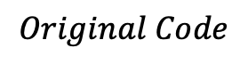
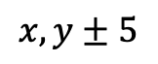
…Back to shape definition
This idea could be introduced in shape mutation too: it could avoid, eventually, random shape re-generation
$$Original Code$$
$$x,y±5$$
Notes:
This idea can be proposed inside the shape definition function, since in this way shapes under change in mutation… can be modified instead of deleted and randomly substituted

Slide 15
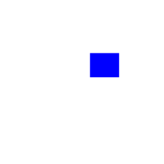

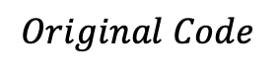
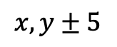
…Back to shape definition
This idea could be introduced in shape mutation too: it could avoid, eventually, random shape re-generation
$$Original Code$$
$$x,y±5$$

Slide 16


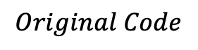
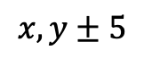
…Back to shape definition
This idea could be introduced in shape mutation too: it could avoid, eventually, random shape re-generation
$$Original Code$$
$$x,y±5$$

Slide 17
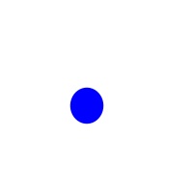

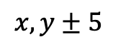
…Back to shape definition
This idea could be introduced in shape mutation too: it could avoid, eventually, random shape re-generation
$$Original Code$$
$$x,y±5$$

Slide 18
Individuals
The original code proposed a Strain Class to handle
Genotype of individuals creation
Crossover for individual creation from parents
Mutation
Leading to a genotype…
Name | Dna | Fitness value
String | {shapes: {type, coordinates}, colors : color tuple} | Scalar

Slide 19
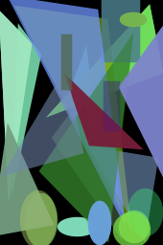
Individuals
The original code proposed a Strain Class to handle
Genotype of individuals creation
Crossover for individual creation from parents
Mutation
Name | Dna | Fitness value
String | {shapes: {type, coordinates}, colors : color tuple} | Scalar

Slide 20
Evolutionary cycle

Slide 21
Evolutionary cycle
Population Initialization

Slide 22
Population Initialization
Parents
Crossover
Additional 10 individuals

Slide 23
Population Initialization
Parents
Crossover
Mutation
Additional 10 individuals
Of the 10 additional individuals

Slide 24
Population Initialization
Parents
Crossover
Mutation
Selection
Additional 10 individuals
Of the 10 additional individuals
Select 5 over 15

Slide 25
Population Initialization
Parents
Crossover
Mutation
Selection
Additional 10 individuals
Of the 10 additional individuals
Select 5 over 15

Slide 26
How is crossover defined?

Slide 27
How is crossover defined?
Each individual has its own Dna, defined of atomic units: the genes
i-th gene

Slide 28
How is crossover defined?
i-th gene
Shape type and
coordinates
Shape color

Slide 29
How is crossover defined?
Individual dna

Slide 30
How is crossover defined?
We start with a parent population: each individual has its dna.
Parent 1
Parent 2
Parent 3

Slide 31
How is crossover defined?
To generate a new individual we select randomly a parent dna and deepcopy it.

Slide 32
How is crossover defined?
Then iterate on parents: change one random gene of in place of another of this offspring
Parent 1
Parent 2
Parent 3

Slide 33
How is crossover defined?
Parent 1
Parent 2
Parent 3

Slide 34
How is crossover defined?
Parent 1
Parent 2
Parent 3

Slide 35
How is crossover defined?
Parent 1
Parent 2
Parent 3

Slide 36
How is crossover defined?
Parent 1
Parent 2
Parent 3

Slide 37
How is crossover defined?
Parent 1
Parent 2
Parent 3

Slide 38
How is crossover defined?
Parent 1
Parent 2
Parent 3

Slide 39
How is crossover defined?
After that, mutation will occur to each new offspring.

Slide 40
How is mutation defined?

Slide 41
Individuals
Three different actions:
New random shape appending to offsprings DNA
Shape change and color change of a gene
Random shape removal to offspring DNA
As introduced before, the function has been changed: now we can change a shape not by deletion and random reinsertion, but deletion and conditionate reinsertion.
len<500 and 25% probability
elif 75% probability
else

Slide 42
(modified*) Original way: performances and results
* Changed mutation, reduced shape size, numpy fitness alternative

Slide 43
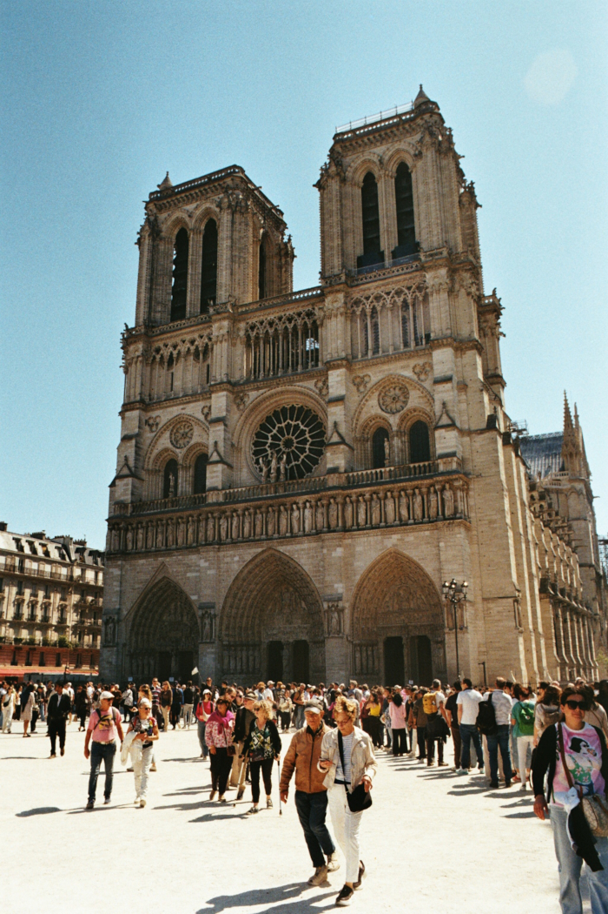
Example on Notre Dame
The example picture is a Notre Dame colored image I took this year in Paris.
The population initial parameters were
Image_size: 170 x 256
Generation_population: 10
Crossover_population: 5
Over 30000 epochs.

Slide 44
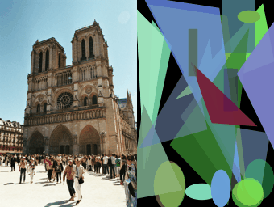

Slide 45
The result isn’t so good…
In addition, evaluation time is a problem
Why don’t we change the approach?

Slide 46
How can we speed up evolution?

Slide 47
How can we speed up evolution?
Multiprocessing patches
evolution
Fitness simplification

Slide 48
Patches idea introduction
The main idea is to take advantage of multi-core processing.
Notice this is related to the number of cores available
Considering that…
The image must be big enough
We cannot evolve on different nodes (evaluation problem)
So the idea is to break and cut the image… into smaller pieces…

Slide 49
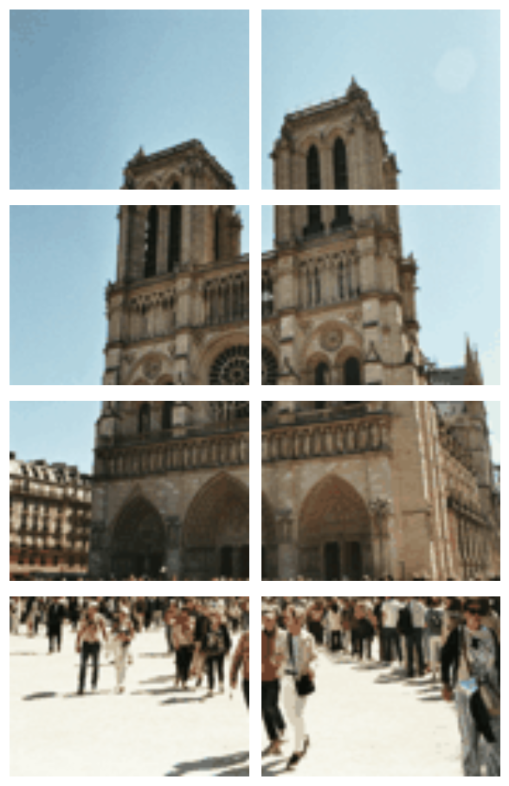
Patches idea introduction
#processes=8

Slide 50
Patches idea introduction
… and evolve independently each piece.
We would have many advantages:
Each core could handle evolution independently on a sub part of the image (patch)
Since shape sizes are canvas related, more precision should be present
We should notice a speed increase since fitness evaluations would be on smaller images, proportional to the number of cores
Over same number of epochs we end up with core-number times more shapes
No assumptions or reduced set of shapes and colors
+ Now we can measure shape sizes with a parameter

Slide 51
Fitness function revisited
+ we can define an alternative fitness which is the L1 norm:
def fitness(self):
return self._fitness or self._fitness_func()
def _fitness_func(self):
ref_img = self.reference_image.convert("RGBA")
draw_img = np.array(self.draw().convert("RGBA"), dtype=np.int16)
ref_img = np.array(ref_img, dtype=np.int16)
diff = draw_img[:, :, :3] - ref_img[:, :, :3]
fitness = np.sum(np.abs(diff))
self._fitness = fitness
return fitness

Slide 52
Modified way: (compared) performances and results

Slide 53
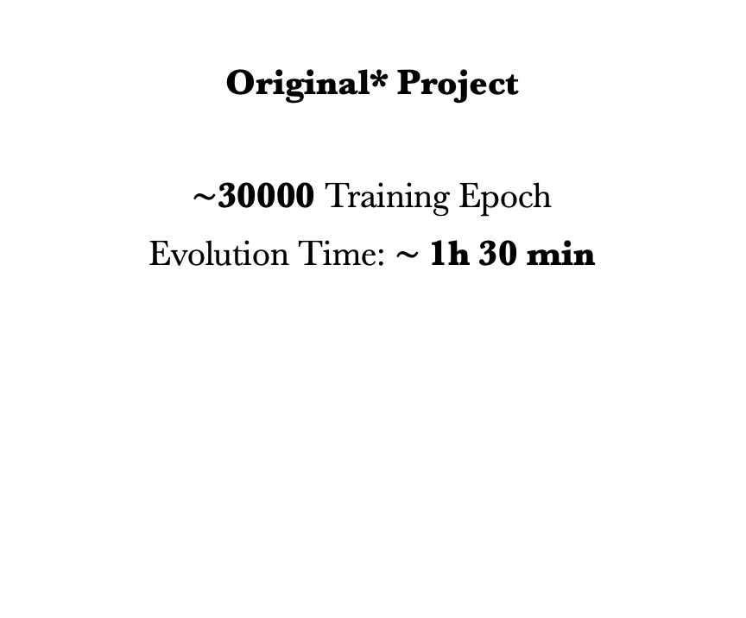
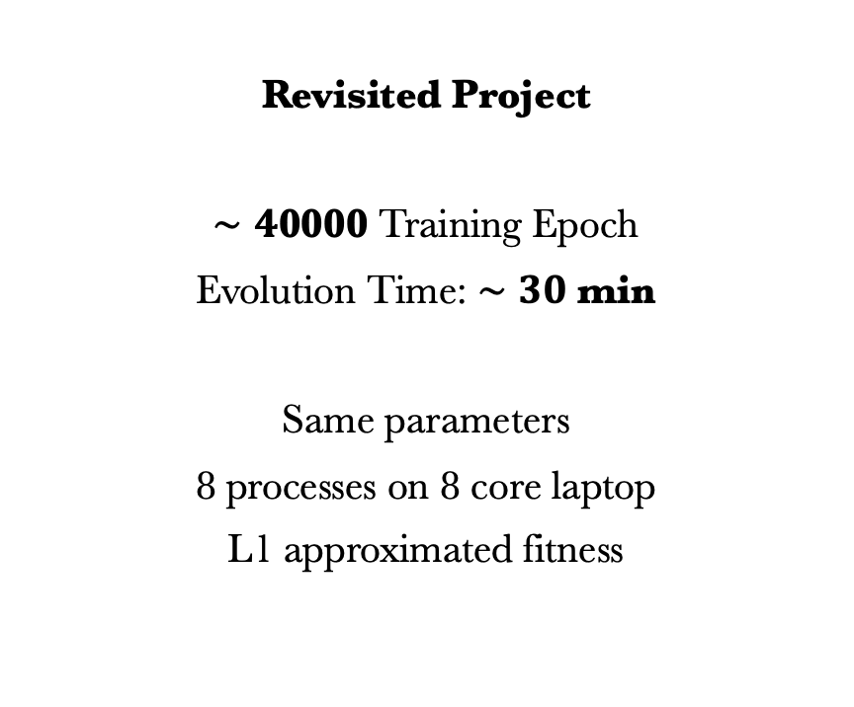
Time comparison
Original* Project
$∼$30000 Training Epoch
Evolution Time: $∼$1h 30 min
Revisited Project
$∼4$0000 Training Epoch
Evolution Time: $∼30$ min
Same parameters
8 processes on 8 core laptop
L1 approximated fitness

Slide 54
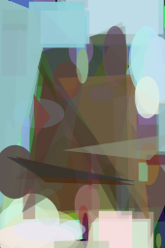
Time comparison
Original*
Reference
Revisited

Slide 55
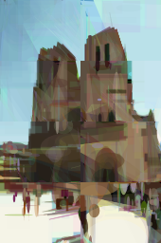
Time comparison
Original*
Reference
Revisited

Slide 56
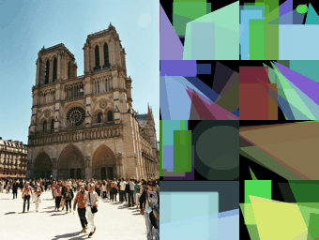

Slide 57
Can we do something more?

Slide 58
Can we do something more?
Shape size reduction
ratio*
* w.r.t. image size

Slide 59
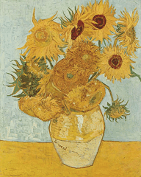
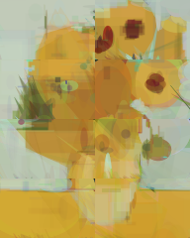
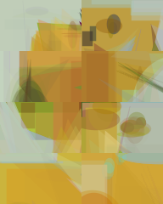
Reference
Small Shapes Evolution
1000 epochs
Big Shapes Evolution
1000 epochs

Slide 60
We see a great improvement with a higher shape size reduction rate on fixed number of patches (8)
Small Shapes
Big Shapes
* The size is proportional to patch reference size

Slide 61
We can finally see results with:
Patches and multiprocessing introduction
More efficient loss
Random re-generation avoidance for shapes and colors
Better shape random generation
Shape size ratio introduction

Slide 62

Time comparison
Reference
Small Shapes Evolution
50000 epochs

Slide 63
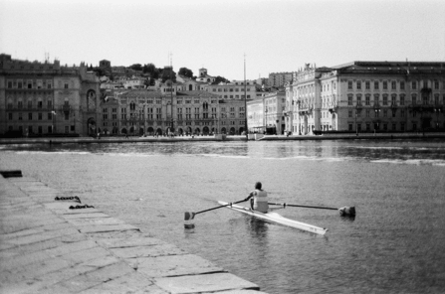
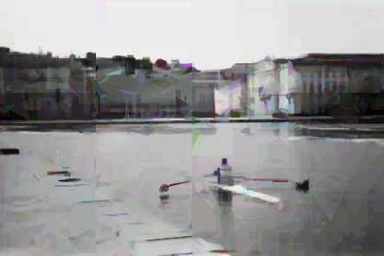
Time comparison
Reference
Small Shapes Evolution
50000 epochs
Notes:
Curious about B/W

Slide 64
Final Notre Dame visual comparison

Slide 65
Time comparison
Original*
Reference
Revisited
Small shape revisited
Notes:
Evolution over 30000 and 50000 epochs

Slide 66
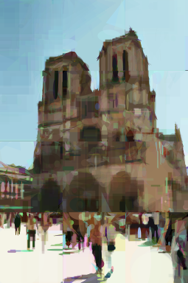
Time comparison
Original*
Reference
Revisited
Small shape revisited
Notes:
Evolution over 30000 and 50000 epochs

Slide 67
Project References
[1] The evolution of a Smile, Peter Braden: https://github.com/peterbraden/genetic-lisa/
[2] Mona Lisa Gif Evolution: https://github.com/peterbraden/genetic-lisa/blob/master/images/lisa-anim.gif
[3] Vase with Twelve Sunflowers (Arles, August 1888), Van Gogh. Neue Pinakothek, Munich: https://commons.wikimedia.org/wiki/File:Vincent_Willem_van_Gogh_128.jpg
[4] La persistenza della memoria, Dalì: https://www.analisidellopera.it/wp-content/uploads/2018/10/Dali_La_persistenza_della_memoria-1.jpg

